Slide 2

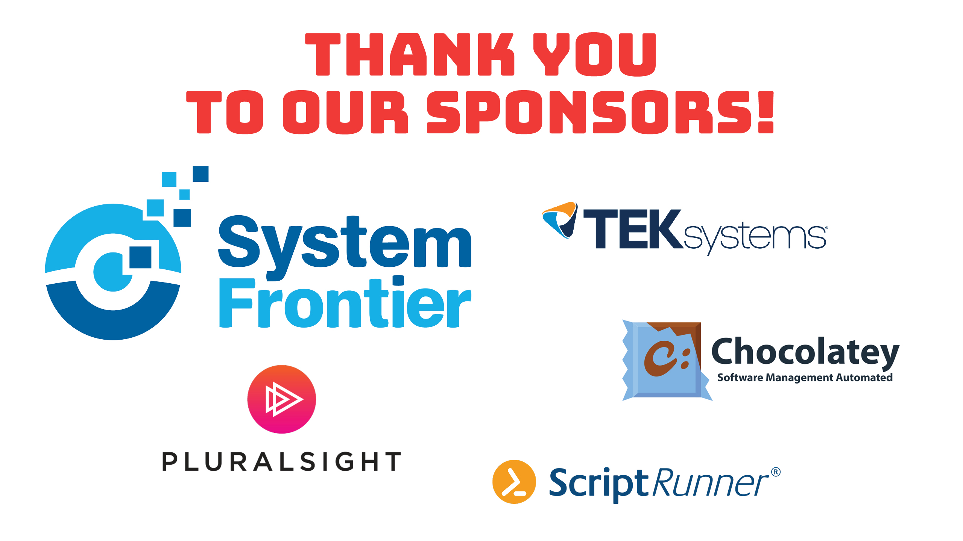

Slide 3


Security 102
Defending Against PowerShell Attacks
Jon Fox
Sr Security PFE
@jofoMSFT
Adopted from a presentation by
Lee Holmes
Lead Security Architect, Azure Management
@Lee_Holmes

Slide 4

Into the Abyss
Notes:
Let’s look at how people are being compromised.
Phishing emails
Document macros
Malicious website links
System compromised in other ways (malicious / compromised admin)

Slide 5
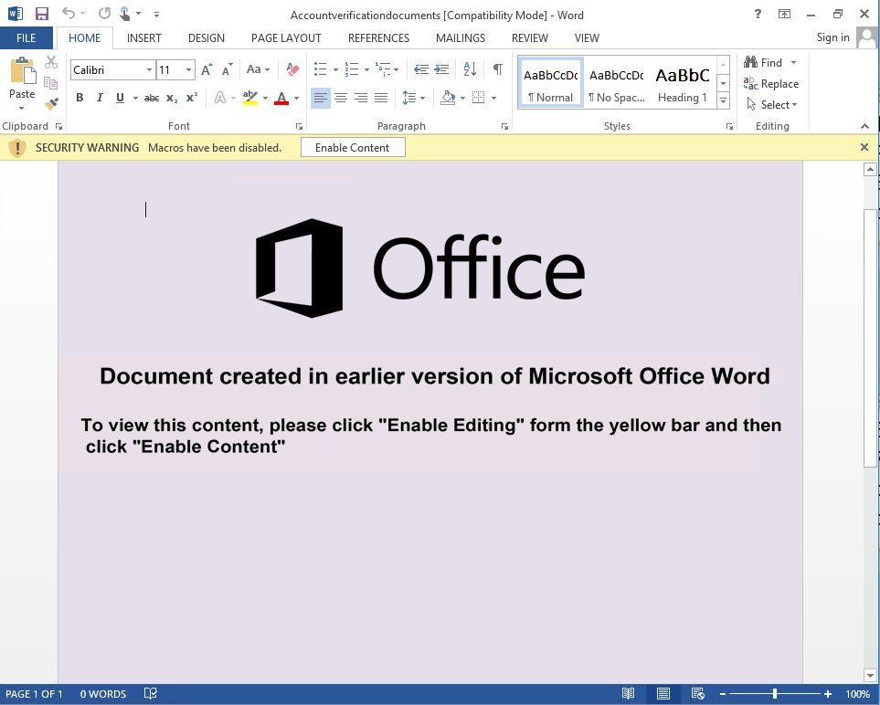
https://twitter.com/JohnLaTwC
Notes:
Example from John Lambert
It’s common to blame phishing victims, but many phishing emails look perfectly legitimate and are very easy to fall for.
Example: partner / subsidiary compromised; attackers respond to active email threads with a document like this one.

Slide 6
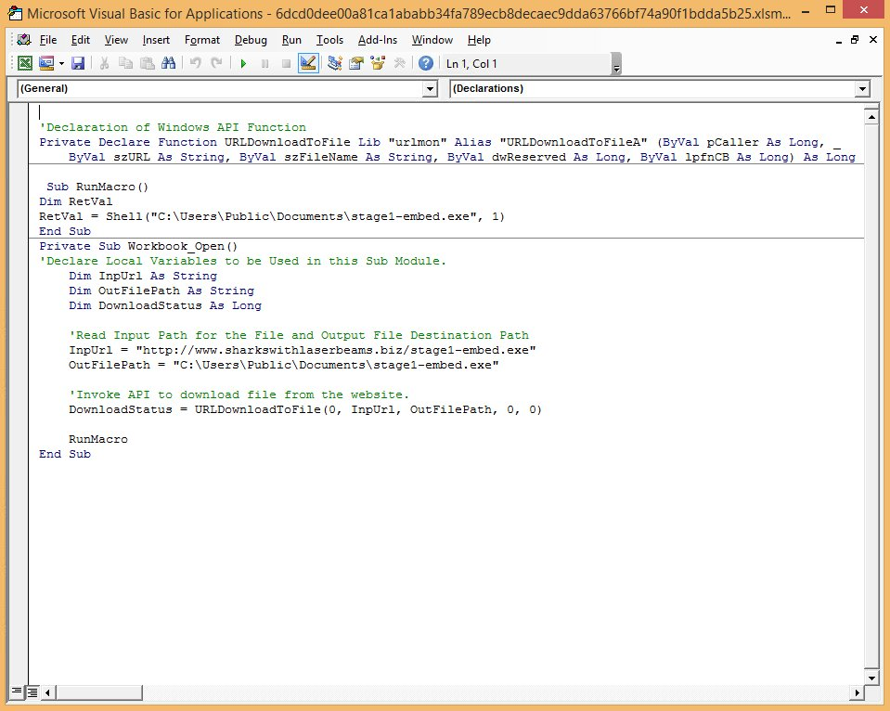
Notes:
Document macro that downloads an executable stager.
VBA is extremely powerful: Win32 APIs, COM objects, etc.
If you can dream it, you can write it in VBA.

Slide 7
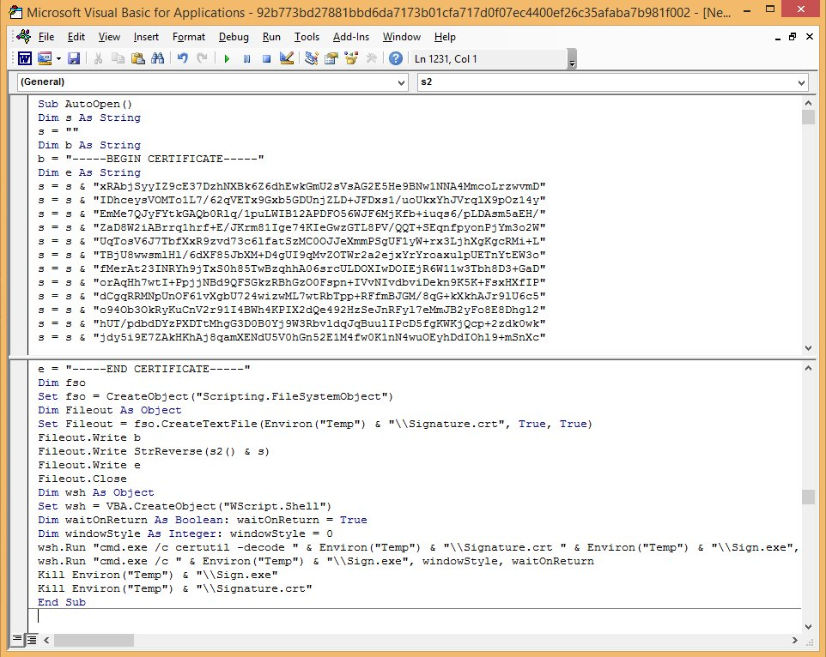
Notes:
A slight variation. Rather than download a stager, this one embeds it, extracts it, and runs it.

Slide 8
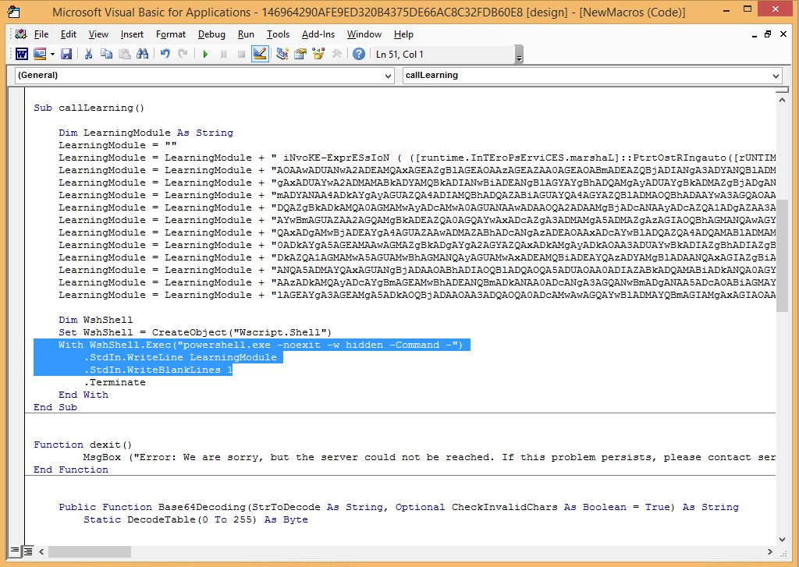
Notes:
A POWERSHELL ATTACK.
PowerShell is just one part of this attack but is the cool trend and gets the headlines.

Slide 9
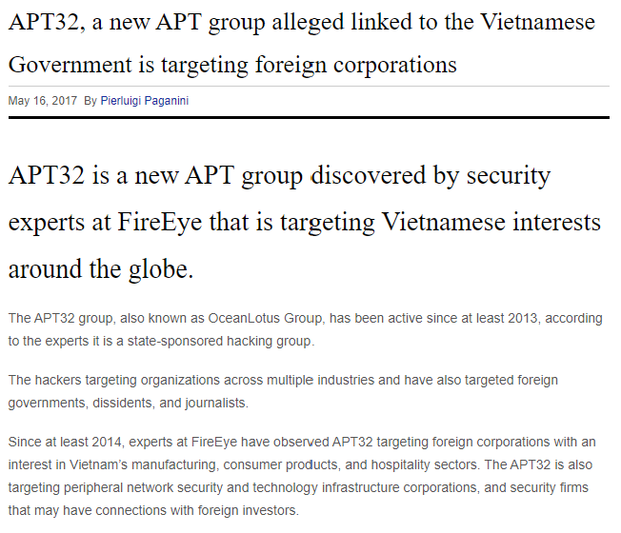
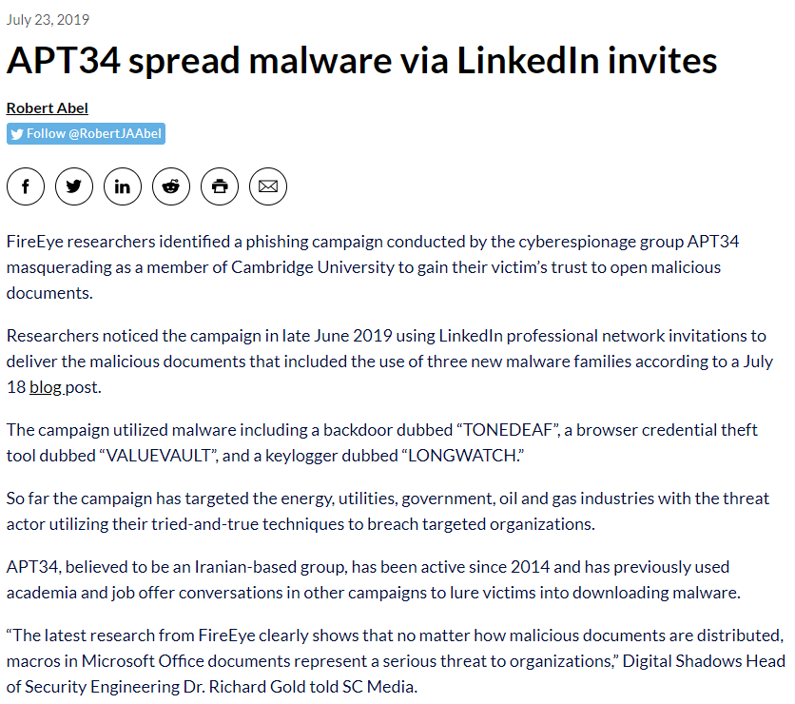
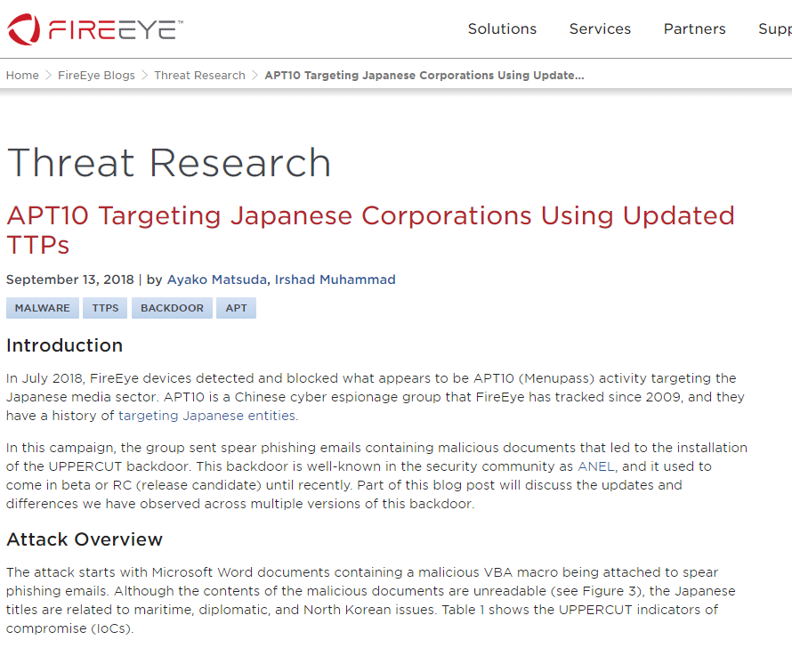
What does AN APT look like?
Notes:
Usually, about the same.
Here’s a few examples from FireEye and Security Affairs about some targeted attacks against banks.
If you’ve seen one VBA macro, you’ve seen them all.
Credits:
https://www.fireeye.com/blog/threat-research/2018/09/apt10-targeting-japanese-corporations-using-updated-ttps.html
https://www.scmagazine.com/home/security-news/apts-cyberespionage/fireeye-researchers-identified-a-phishing-campaign-conducted-by-apt34-masquerading-as-a-member-of-cambridge-university-to-gain-their-victims-trust-to-open-malicious-documents/
https://securityaffairs.co/wordpress/59149/apt/apt32-vietnamese-government.html

Slide 10
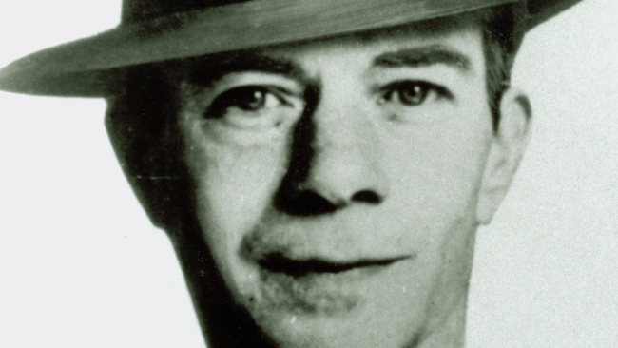
SUTTON’S LAW
Why do people rob banks?
Because that's where the money is!
Notes:
Photo credit:
https://arca.com/resources/blog/why-do-people-rob-banks-because-thats-where-the-money-is

Slide 11
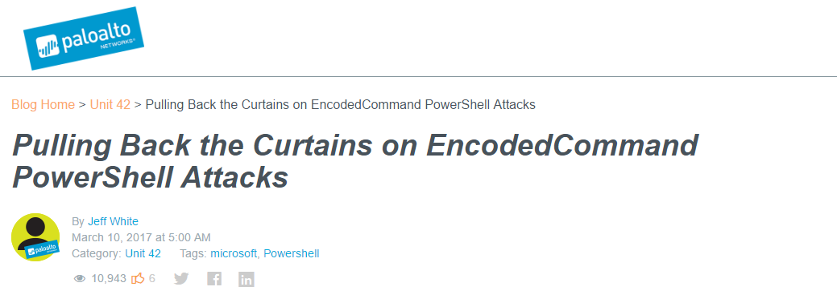
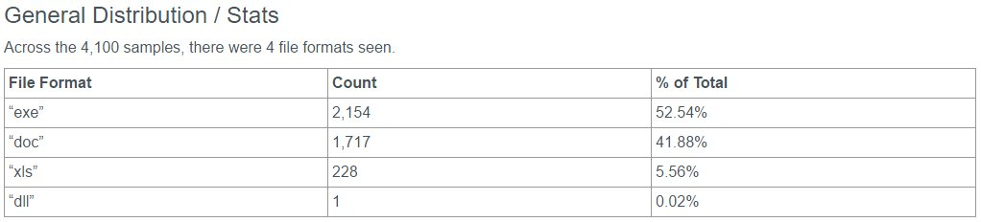
http://researchcenter.paloaltonetworks.com/2017/03/unit42-pulling-back-the-curtains-on-encodedcommand-powershell-attacks/
Notes:
Let’s dive a little deeper into those PowerShell attacks.
Palo Alto’s Unit 42 did a great analysis of the initial entry point of some attacks that leveraged PowerShell at some point.
The vast majority started as an exe, doc, or spreadsheet macro.
(BTW: All this data on GitHub)

Slide 12
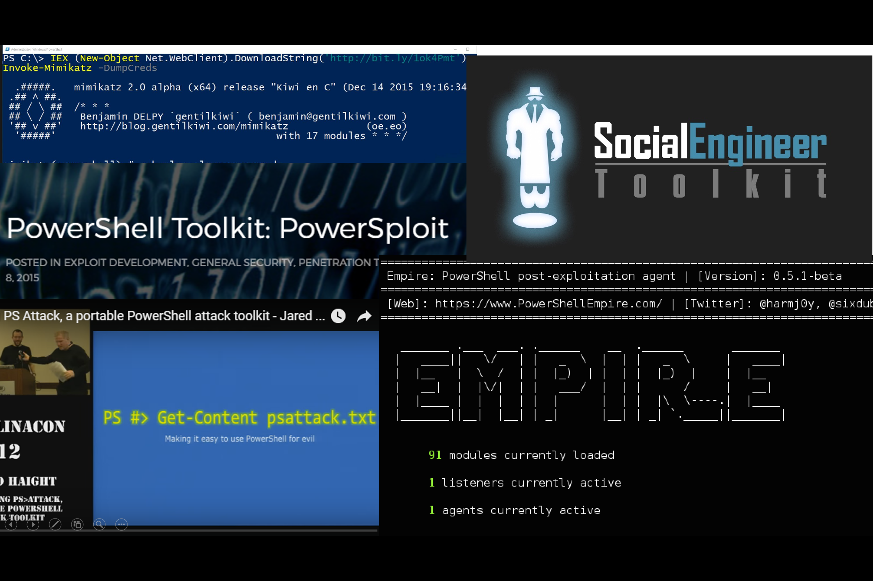
PowerShell for Post-Exploitation
Notes:
PowerShell is popular with Pen testers for the same reason it is popular as an administration tool.
It is easy to use and very powerful!
Access to Windows APIs
Access to .NET
Claimed benefit: Forensically clean / in-memory only.
Question: When is the last time you saw an organization with forensic capability, let alone reverse engineering capability?
Operationally, it’s a moot point – as almost all PowerShell use is some variant of an executable download cradle.

Slide 13
(Some) Post-Exploitation options
On a compromised machine
Compiled exe files
DLLs (i.e.: Load Path tampering, application dependencies)
Perl
Python
Ruby
Bash
VBScript
JScript
COM objects
Macros / Visual Basic for Applications (VBA)
csc.exe
HTML Applications (HTAs)
SQL
PowerShell
Notes:
PowerShell first became a viable attack technique in 2008. What did attackers do before then? What can they do without?
There are many ways to do nefarious work on a compromised machine.
PowerShell is one of them. But there are others.

Slide 14
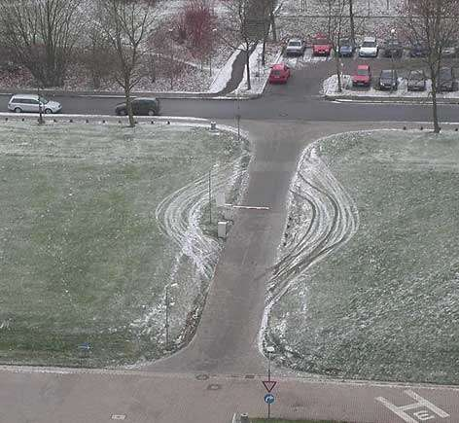
Let’s Block Powershell!
Doesn’t address the underlying security problem
Removes your most secure and security-transparent management tool
Notes:
Addressing PowerShell is very important (and we will be talking about it more later).
But it is not going to solve your security problem, and at best is a small speed bump.
So you get rid of PowerShell. But now you need to turn to less secure alternatives solutions for managing your system. Like keeping a GUI on your servers.
RDP? Good luck with that! Hope you’re in a giving mood, since you’re donating your credentials to every system you touch.
PowerShell also has incredible utility for Blue Teamers: patch management, IOC sweeping, threat hunting, you name it.

Slide 15
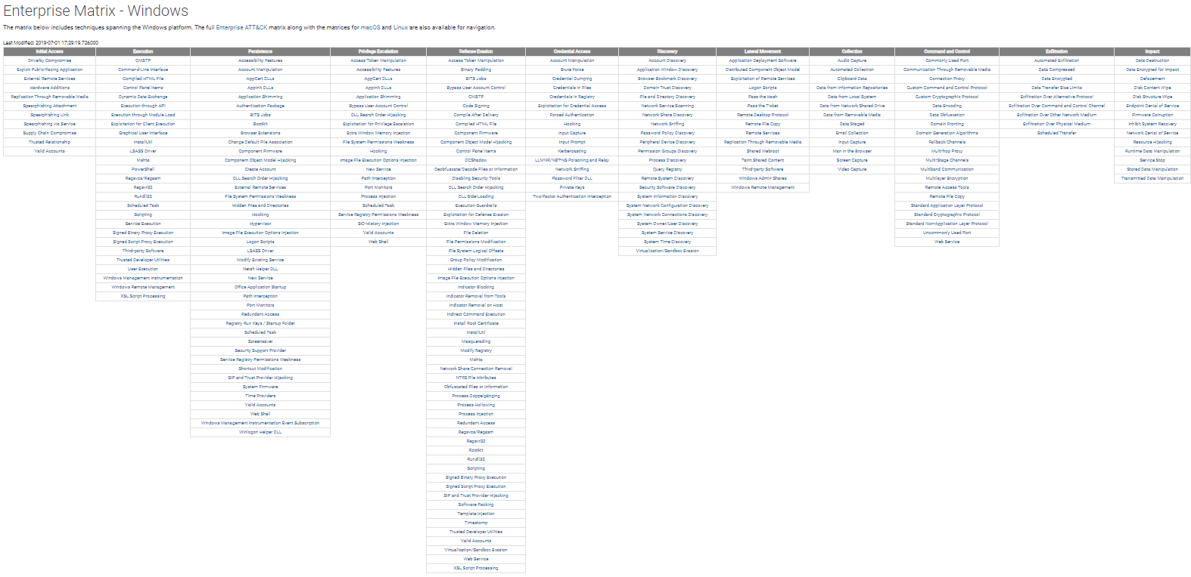
https://attack.mitre.org/matrices/enterprise/windows/
Notes:
The MITRE attack framework, which describes tools and techniques commonly used by attackers.
The breadth of activities is stunning.
“PowerShell” is highlighted. If you truly block PowerShell, this will not have made much of an impact on attackers.
What it WILL have done is remove the management tool that offers the greatest insight into attacker activity.

Slide 16
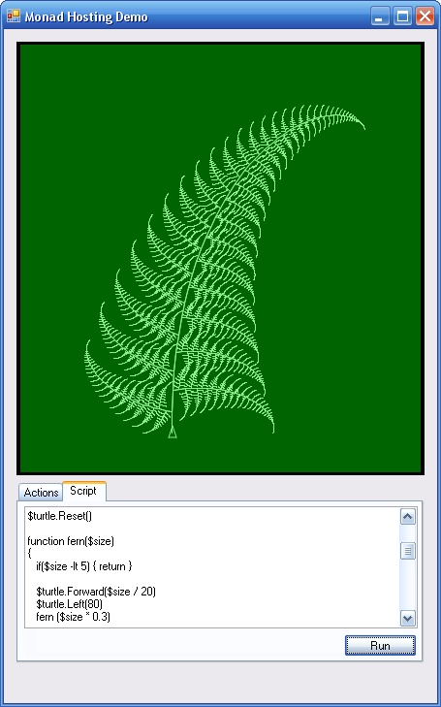
Oops!
PowerShell
Isn’t Just
PowerShell.exe
https://blogs.msdn.microsoft.com/powershell/2013/10/01/paap-windows-powershell-as-a-platform-part-1/
Notes:
Don’t forget that PowerShell isn’t just PowerShell.exe. PowerShell is an automation engine (primarily System.Management.Automation.dll) upon which applications can build.
PowerShell.exe is one common interface to that engine.
If you allow arbitrary EXEs, there are other PowerShell hosting applications and tool sets (such as PowerShell Empire or PS Attack) that host the PowerShell engine.
You might never see powershell.exe running even though PowerShell is running on the system.
Ben Ten: “Not PowerShell” presentation

Slide 17
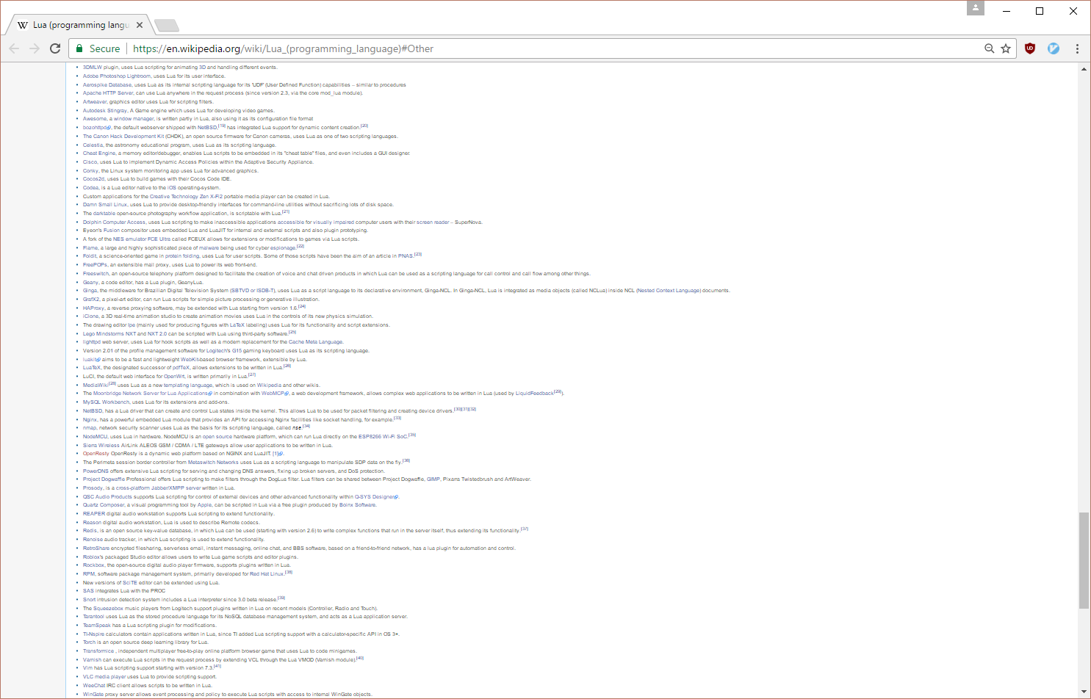
Notes:
And then there’s LUA. A very popular hostable scripting language.

Slide 18
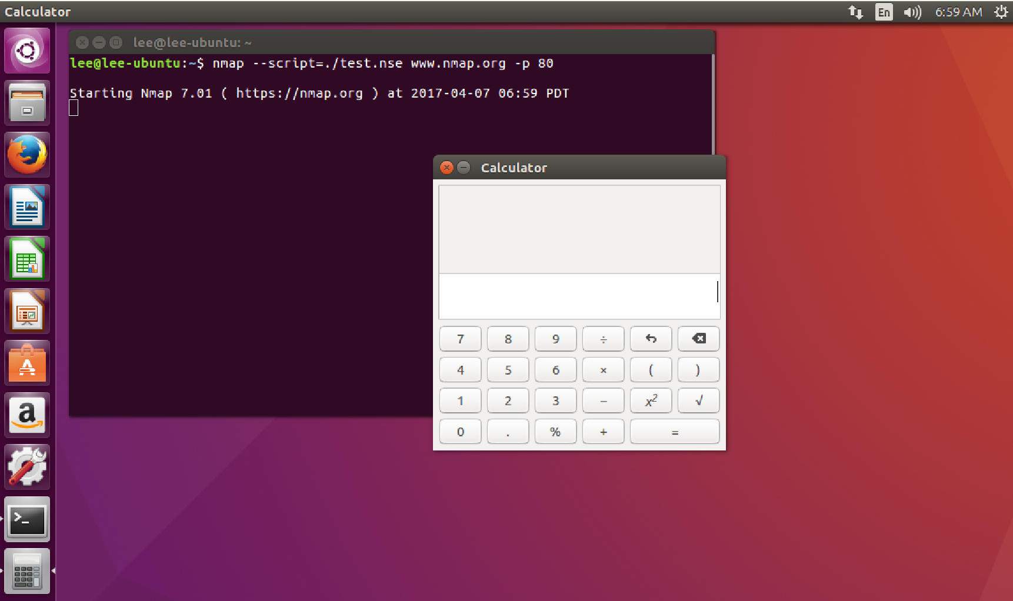
https://nmap.org/book/nse.html
Notes:
But LUAs safe, right? Here is an example of using a popular scripting tool and invoking arbitrary executables.

Slide 19
Maslow’s Hierarchy
of Security Controls
Remediate
Forensic capture of memory-based artifacts
Detect
Forensic capture of host-based artifacts
Auditing of Protections
Application Whitelisting in “Allow” Mode
Prevent
Application Whitelisting in “Deny” Mode
Patching & Antivirus
http://www.leeholmes.com/blog/2014/12/08/maslows-hierarchy-of-security-controls/
Notes:
Security capability is a combination of prevention, detection, and remediation skills.
By the time an attacker is running PowerShell, you’ve already been breached.
Blocking PowerShell is one approach, but an alternative approach is to improve your detection and remediation skills.
This presentation from Mandiant (“No Easy Breach”) is a perfect example of this – installing PowerShell w/ its improved logging was the one act that broke the case open.
https://archive.org/details/No_Easy_Breach

Slide 20
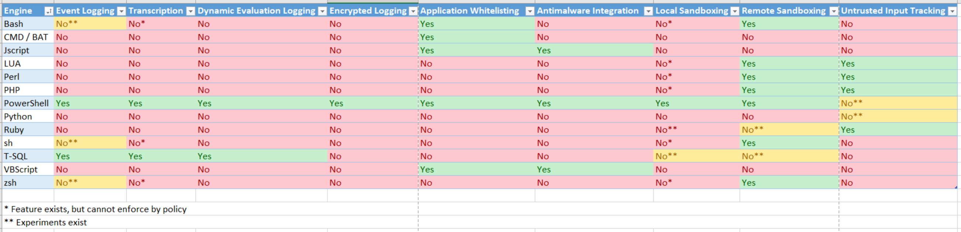
We’re Listening
https://blogs.msdn.microsoft.com/powershell/2017/04/10/a-comparison-of-shell-and-scripting-language-security/
Notes:
The PowerShell team is aware and listening.
We’ve invested more than any other shell or programming language to make it by far the most security transparent code execution engine available.

Slide 21
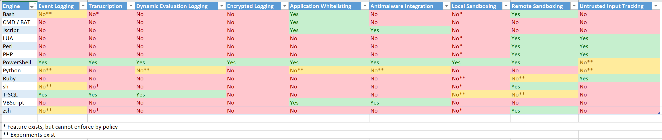
We’re Listening
https://blogs.msdn.microsoft.com/powershell/2017/04/10/a-comparison-of-shell-and-scripting-language-security/
Notes:
One interesting addition to this story is Python. Microsoft has been working with the Python community on current and upcoming releases,
which has the chance to bring some of PowerShell’s security features into Python itself – another very capable tool enjoyed by attackers.
https://www.python.org/dev/peps/pep-0551/

Slide 22




Just Enough Administration (JEA)
Server1
PS> mstsc /v Server1 Access Denied
“Jeffrey I need to be admin on Server1 to restart DNS”
“No gentilkiwi.
Just use PowerShell to connect to the server”
PS> Enter-PSSession Server1
Server1> Restart-Service Dns
☺
Server1> Steal-Secrets Error: You are not authorized to Steal-Secrets
Notes:
JEA: You reduce your risk to all attacks if you limit the number of people with administrative access to machines.
You also reduce attack risk by restricting the capabilities of individual accounts or groups.

Slide 23
Security Exposure = Time X Capability
Capability
Time
Notes:
The security exposure coming from your admins is:
The time in which they have administrative access
The amount of access they have

Slide 24
Privileged Identity Management = Time
Capability
Time
Notes:
One thing our industry has started to wrap its head around is reducing the duration of administrative access.
The Privileged Identity Management category has started to fill in these gaps, you might already be using this.

Slide 25
Just Enough Administration = Capability
Capability
Time
Notes:
A second axis of security exposure is capability: what the user / administrator can do.
Or an attacker with access to that user’s credentials.
Does your DNS administrator need to be a domain admin?

Slide 26
JEA Role Capability Example
@{
# Description of the functionality provided by these settings
Description = 'Role Capabilities for DNS Maintenance'
# Modules to import when applied to a session
ModulesToImport = 'DnsServer'
# Cmdlets to make visible when applied to a session
VisibleCmdlets = 'Get-Service', 'Restart-Service',
'Get-DnsServerCache', 'Clear-DnsServerCache',
'Show-DnsServerCache'
# Functions to define when applied to a session
FunctionDefinitions = @{
'Name' = 'whoami'
'ScriptBlock' = { $PSSenderInfo } }
}
Notes:
You specify what commands are visible, what modules are allowed in the session.
You can also define complex and powerful functions through custom commands.

Slide 27
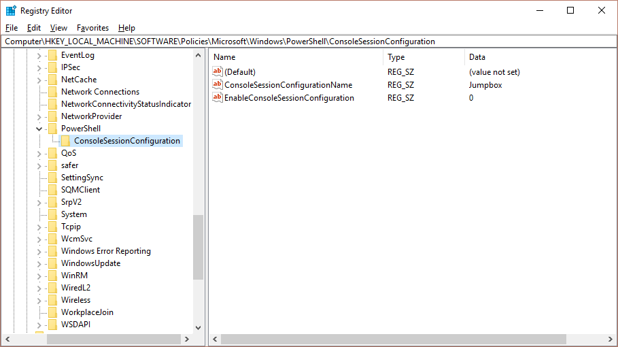
Local Sandboxing
Notes:
PowerShell also lets you configure all local sessions to run in the constraints of a JEA session.
This is a great opportunity for things like Jump Boxes.

Slide 28
Just Enough Administration!
Capability
Time
https://aka.ms/jea
Notes:
JIT+JEA is a very important way to limit the security exposure to your systems.
Folks that have blocked PowerShell or PowerShell Remoting are then forced to have domain administrators running around everywhere.

Slide 29
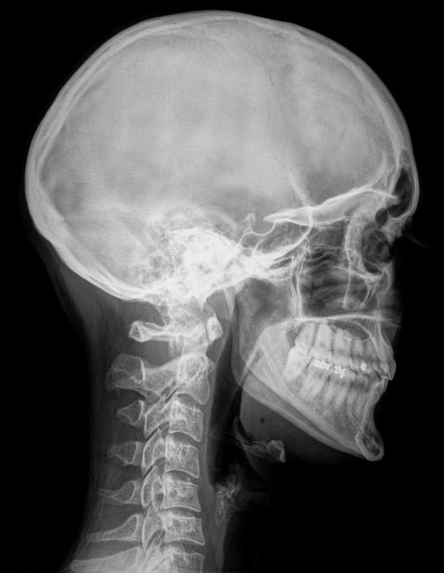
Making PowerShell
Security Transparent
Module / Pipeline logging
System-wide transcripts
Script Block logging
Antimalware Integration
Notes:
Another huge benefit of PowerShell is security transparency.
If a machine has been compromised, it’s not game over.
An attacker still needs to meet their objective.
Your leverage is the security transparency of the tools you (and they) use.

Slide 30
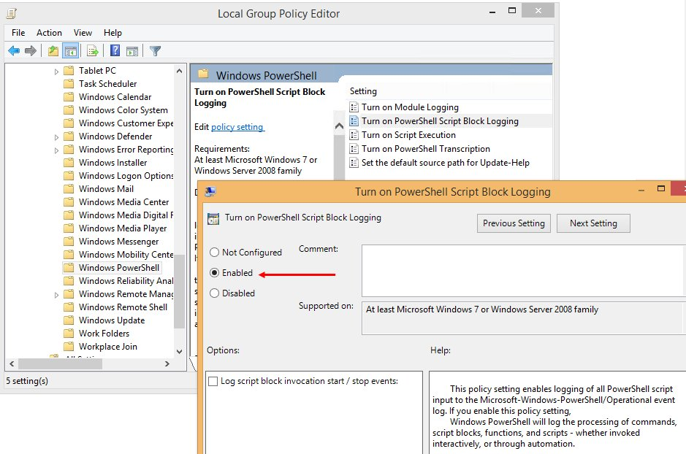
Configuration
Notes:
You can configure PowerShell’s security features through either Group Policy, or the registry directly.

Slide 31
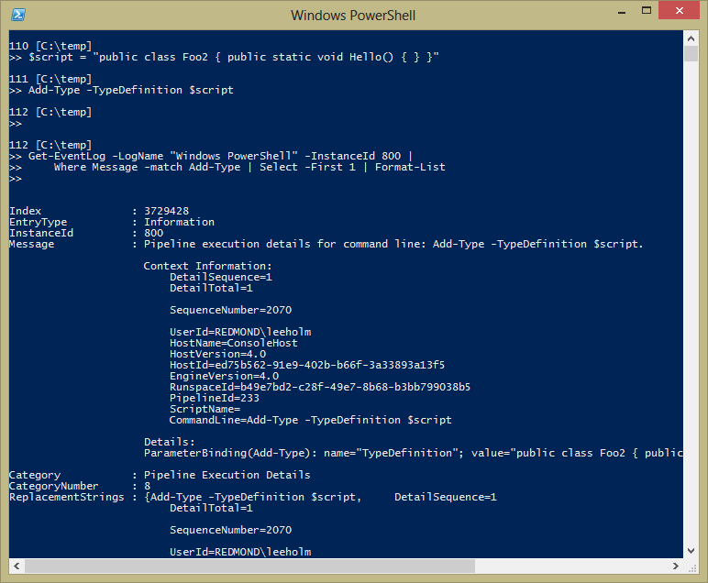
Module / Pipeline Logging
Notes:
Enabled by Group Policy or interactively. Can see all the commands that were run and their parameters.

Slide 32
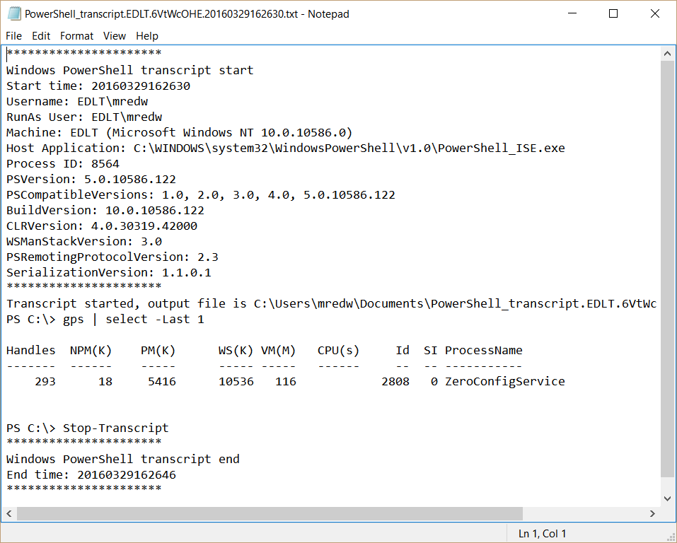
System Transcripts
Notes:
Over the shoulder view of all PowerShell commands being run on the system, including input/output.
You can also redirect the logs to a remote system so that a compromised system cannot see or delete the transcripts.
Note: RunAsUser, Host Application

Slide 33
Script Block Logging
Notes:
ScriptBlock Logging “completely” destroys any attacker’s hope of being forensically clean.
Every single chunk of text that PowerShell is asked to understand gets logged.

Slide 34
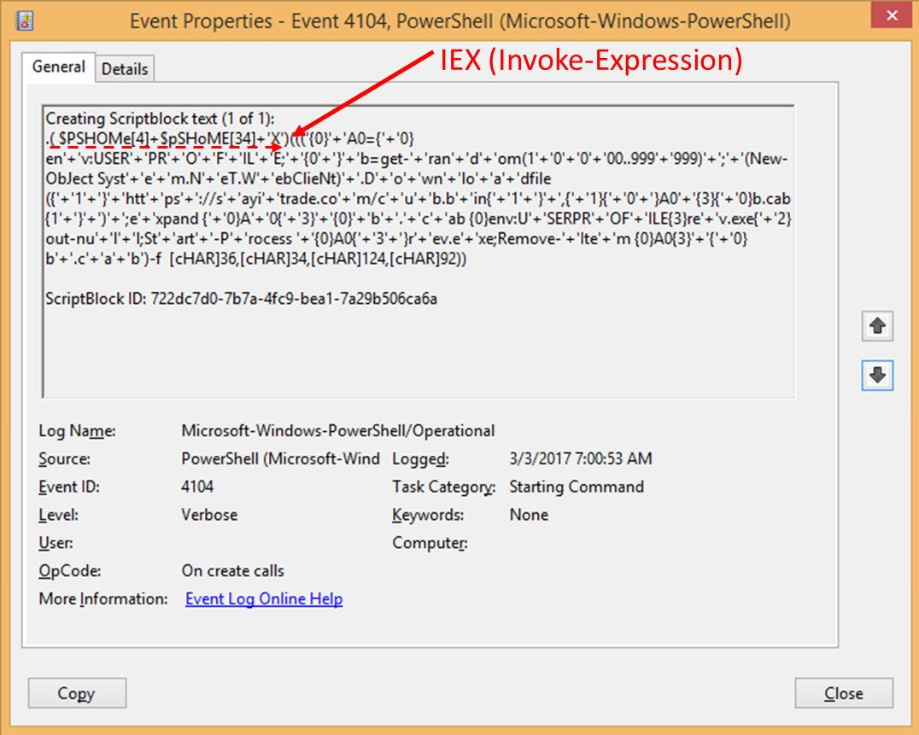
Notes:
An example of an obfuscated download cradle from Daniel Bohannon’s Invoke-Obfuscation.
Obfuscation is not unique to PowerShell; this is just a PowerShell example.
Very difficult to detect specific terms, since ways to obfuscate is unlimited.

Slide 35
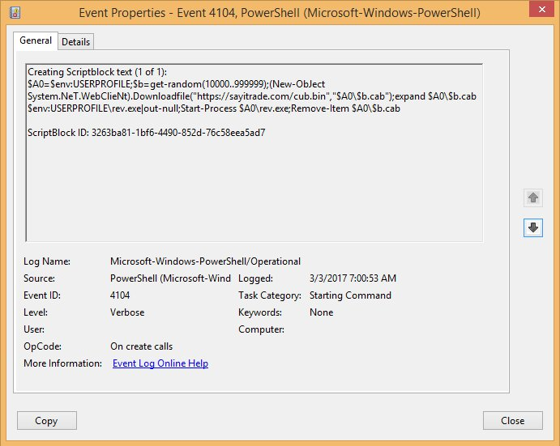
Notes:
Script block logging shows the actual content being run.
“No Easy Breach” from Mandiant used this heavily to finally crack open one of their most difficult investigations to date.

Slide 36
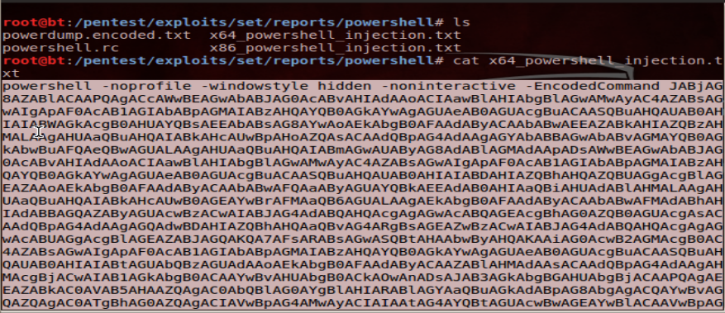
Antimalware Integration (AMSI)
https://blogs.technet.microsoft.com/mmpc/2015/06/09/windows-10-to-offer-application-developers-new-malware-defenses/
Notes:
On Win10+, that exact same script block logging stream is also sent to registered Antimalware engines.
So now even nested levels of obfuscated script text (or command-line input) can be detected with the AMSI interface.

Slide 37
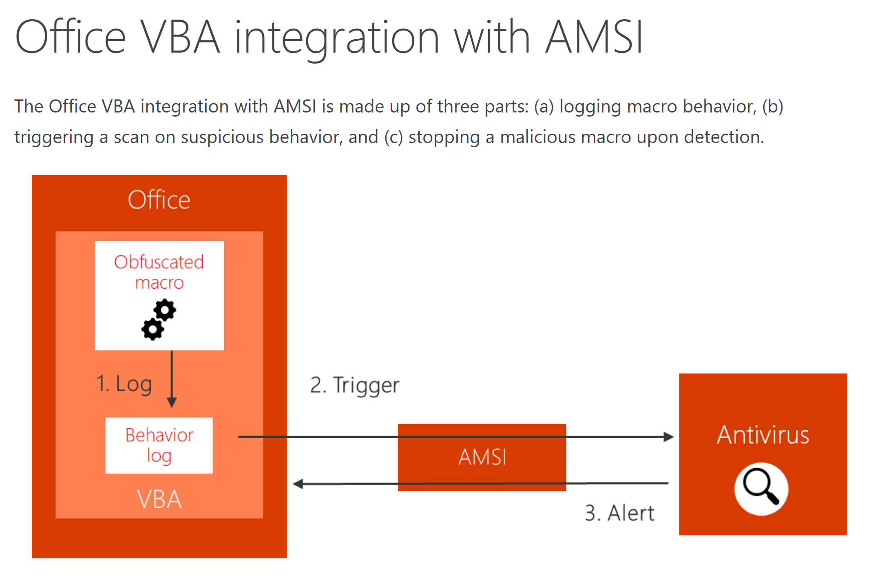
https://www.microsoft.com/security/blog/2018/09/12/office-vba-amsi-parting-the-veil-on-malicious-macros/

Slide 38
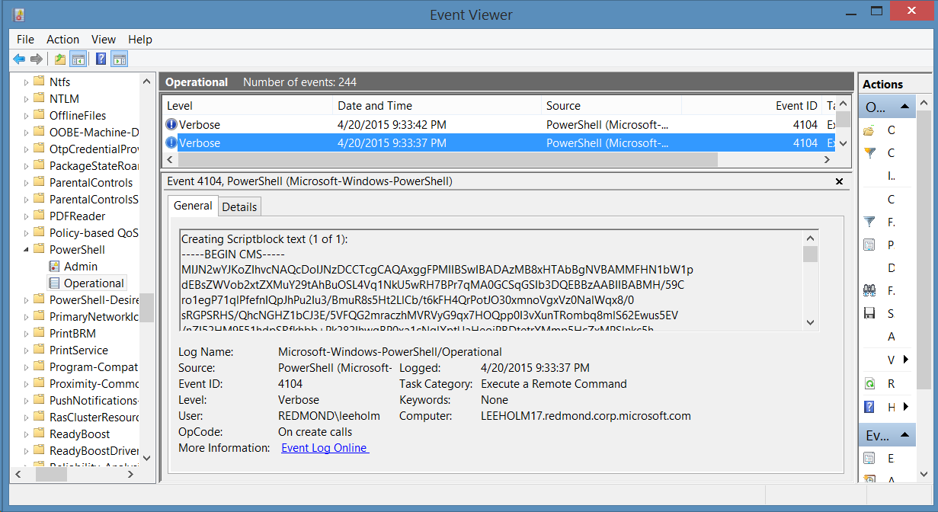
Protected Event Logging
Notes:
With all of this script block logging, you may be concerned about potential Information Disclosure issues.
PowerShell also supports encrypting script block event logs, so they are viewable only on a secure event collection system.

Slide 39
Useful Events
Log Name | Event ID | Purpose
System | 104 | An event log was cleared
Security | 4656 | Auditing of configured files, registry keys: PowerShell profiles (*profile*.ps1) Security settings (HKLM:\Software\Policies\*)
Windows PowerShell | 400 | PowerShell Startup, including hosting application, version
Windows PowerShell | 800 | Command and Parameter Logging
Microsoft-Windows-PowerShell/Operational | 4104 Warning | ScriptBlock automatic logging – used APIs or techniques commonly associated with malware
Microsoft-Windows-PowerShell/Operational | 4104 Verbose | ScriptBlock logging
Microsoft-Windows-PowerShell/Operational | 53507 | PowerShell debugger attached to a process
Microsoft-Windows-WinRM/Operational | 91 | User connected to system with PowerShell Remoting
https://www.fireeye.com/content/dam/fireeye-www/global/en/solutions/pdfs/wp-lazanciyan-investigating-powershell-attacks.pdf
Notes:
Note: 4104/Warning is NOT a replacement for an intrusion detection system.

Slide 40
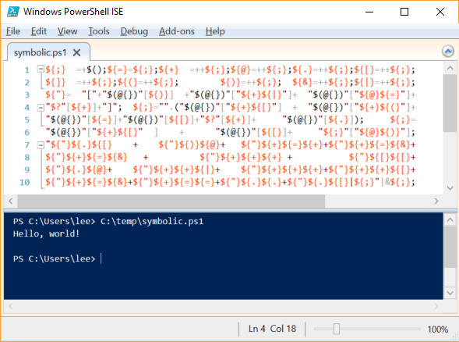
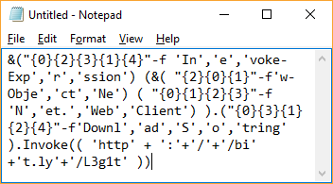
Post-Processing Event Logs
https://github.com/danielbohannon/Invoke-Obfuscation
Notes:
We talked about script block logging, and now there’s a whole ream of post-collection analysis you can do.
For example, attackers trying to hide from signatures by obfuscating scripts are in fact generating a massive signal.
Obfuscation is not normal!

Slide 41
The PowerShell AST
ScriptBlockAst
NamedBlockAst: Begin
NamedBlockAst: End
StatementAst
PipelineAst
CommandAst
StringConstantExpressionAst
CommandParameterAst
ParenExpressionAst
PipelineAst
BinaryExpressionAst
Left: StringConstantAst
Operator: Format
Right: ArrayLiteralAst
0: StringConstantExpressionAst
1: StringConstantExpressionAst
Get-Command -Name ("{1}{0}" -f "-Process","Get")
Generic
LParen
Format
Comma
RParen
Parameter
StringExpandable
StringExpandable
StringExpandable
Notes:
The PowerShell AST (abstract syntax tree) provides incredible insight into the structure of a script.

Slide 42
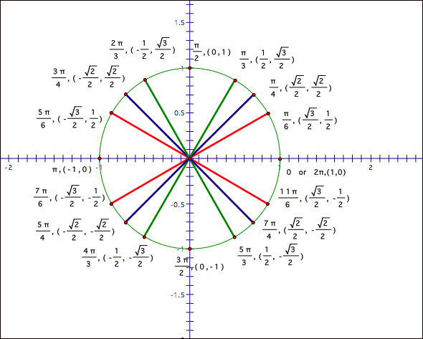
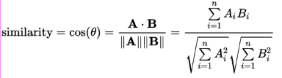
Cosine SImilarity
Notes:
Cosine similarity gives us the equivalent of the angle (similarity) between two vectors (lists of numbers).
This is an interesting technique to apply to character frequencies in scripts to try and detect obfuscation.

Slide 43
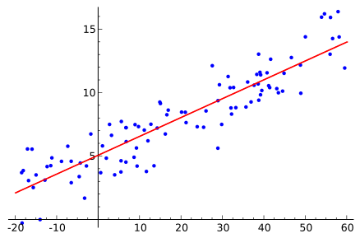
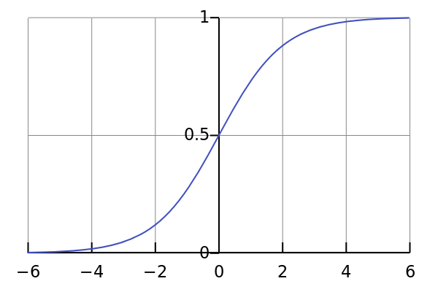
Logistic Regression
+
=
Linear Regression + Logit Function, Sitting in a Tree… M.A.T.H.I.N.G
https://en.wikipedia.org/wiki/Logistic_regression
Notes:
Applying Logistic Regression to the AST a script (the structure and techniques used by the script)
proves to be a very useful statistical tool to detect obfuscation.

Slide 44
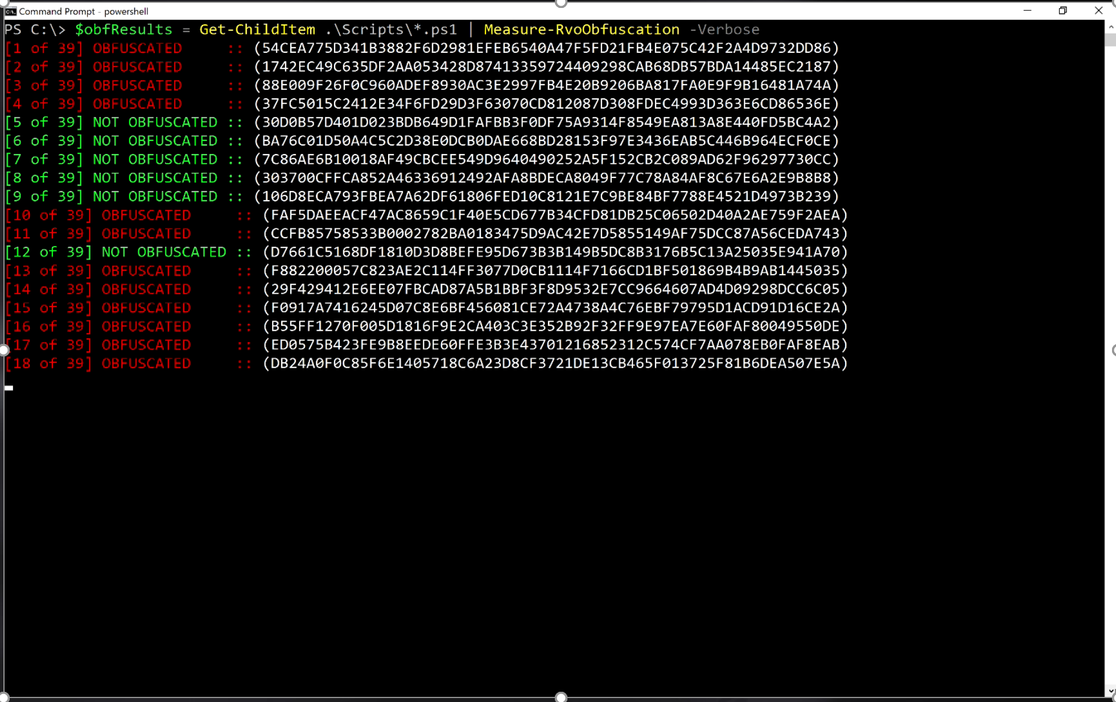
Reliable obfuscation detection
Notes:
Daniel Bohannon and Lee Holmes released a tool called Revoke-Obfuscation at Black Hat, DEF CON, and DerbyCon 2017
The entire presentation is available here:
https://www.youtube.com/watch?v=x97ejtv56xw
https://www.fireeye.com/blog/threat-research/2017/07/revoke-obfuscation-powershell.html

Slide 45
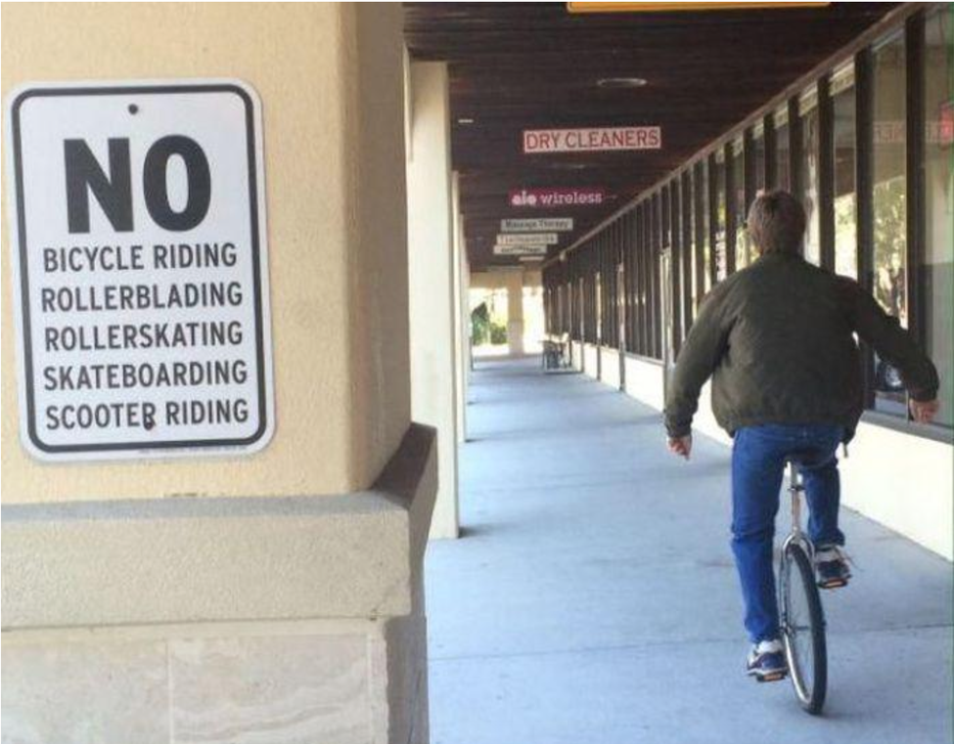
Device Guard and Application Whitelisting
https://channel9.msdn.com/Events/Ignite/2015/BRK2336
Notes:
Blocking known bad applications, scripts, and malware is a good start for defenders. One issue is that it is easy to bypass.
Ideally move to application whitelisting to define a policy that allows only known good.
Device Guard in Windows 10 is the best answer to this, and you also have AppLocker for downlevel systems.
However, one challenge is: how does a management shell and scripting language play in this world?

Slide 46
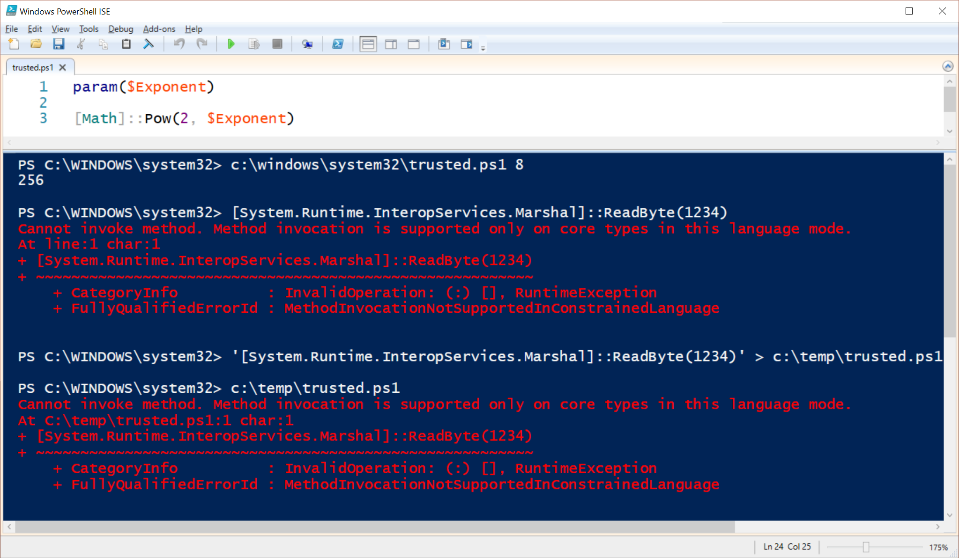
PowerShell With Device Guard
Notes:
The answer is Constrained Language mode: a day to day version of the PowerShell language
Lets you run cmdlets, basic scripting (loops etc.), and that’s about it.
PowerShell automatically employs this language mode when Application Whitelisting is enabled.
Interactive PowerShell runs in Constrained Language.
Out-of-policy scripts and modules run in Constrained Language
In-policy scripts and modules run in full language: everything you need and depend on for advanced management tasks.

Slide 47
PowerShell Constrained Language Restrictions
Language elements that provide access to Win32 APIs
COM objects
.NET methods, property setters, types, and conversions
Add-Type
XAML-based workflows
PowerShell Classes (because they create .NET classes)
DSC configuration declarations
Constrained Language removes the language capabilities that make PowerShell useful for attackers.
It is not a RBAC sandbox like JEA.
Like cmd.exe, it is designed to allow interactive administration, and therefore still allows access to executables and cmdlets.
Notes:
Constrained PowerShell allows traditional scripting language elements such as if/then/else, loop constructs, etc.
Disallows the kind of language features loved and abused by attackers to run shellcode / etc.
Not a full sandbox – you can still delete files, format hard drives, etc.
WMIPlant is an example RAT that uses only basic scripting + WMI, although it could just as well be written in Batch files + WMIC

Slide 48
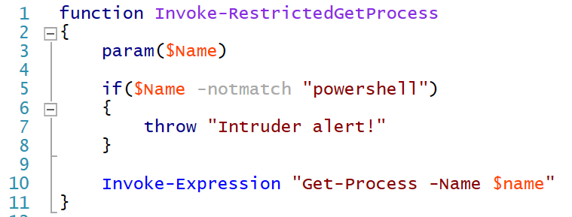
Secure Coding
https://blogs.msdn.microsoft.com/powershell/2013/12/16/powershell-security-best-practices/
Notes:
When you expose PowerShell scripts to untrusted users (i.e.: ConstrainedLanguage or a JEA function), you do need to be aware of secure coding practices.
Like other languages, it is possible to write scripts that take untrusted input across a security boundary and run them.
Matt Graeber: Defensive Coding Techniques for a High Security Environment

Slide 49
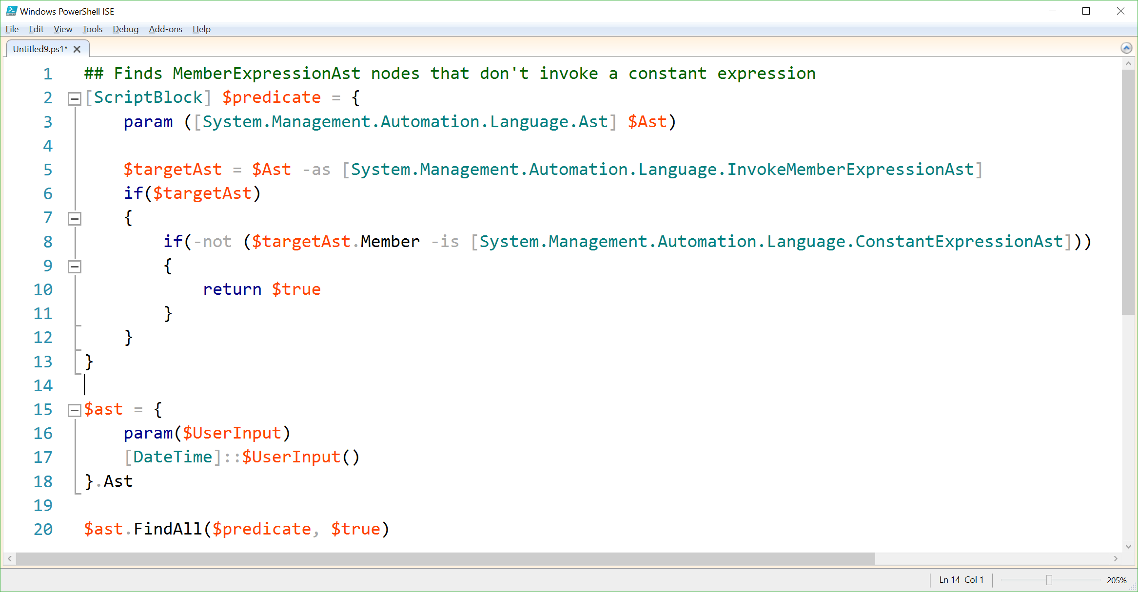
Hunting with the AST
Notes:
The incredible structure of the AST lets you do advanced analysis of potentially dangerous coding techniques

Slide 50
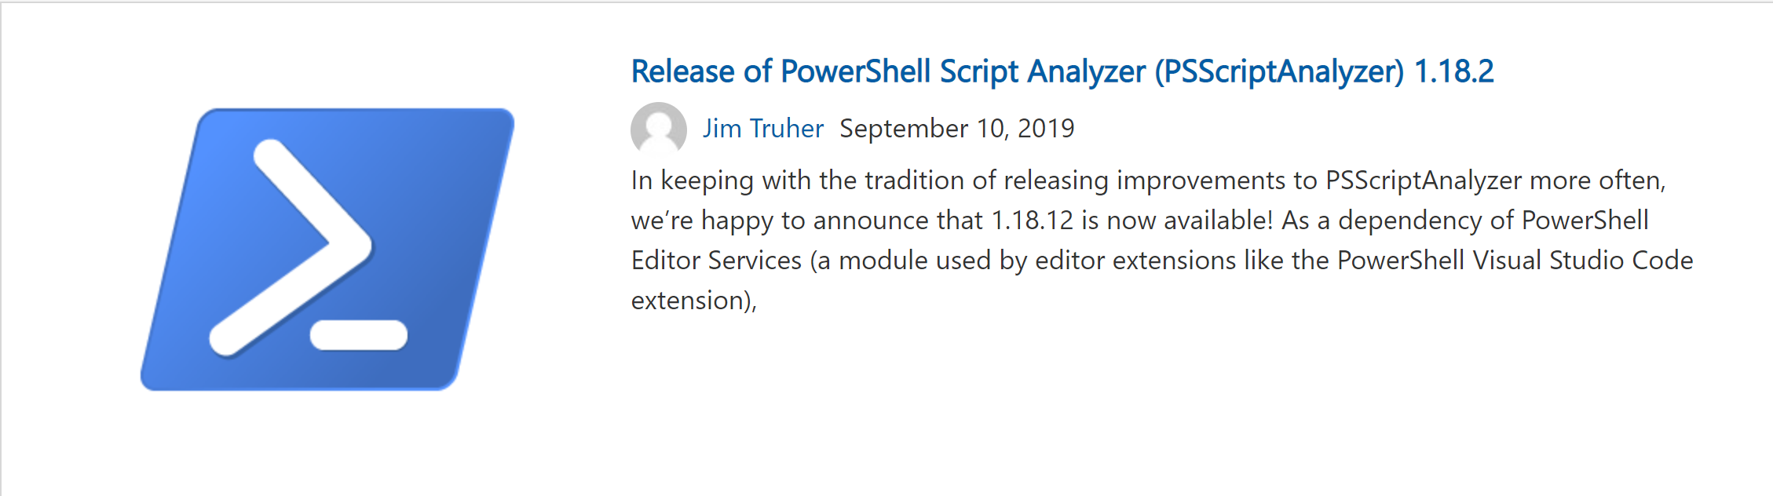
… at scale
https://devblogs.microsoft.com/powershell/release-of-powershell-script-analyzer-psscriptanalyzer-1-18-2/
Notes:
PowerShell Script Analyzer lets you do this at scale. It forms the foundation of all syntactic checks built into the PowerShell extension for Visual Studio Code.

Slide 51
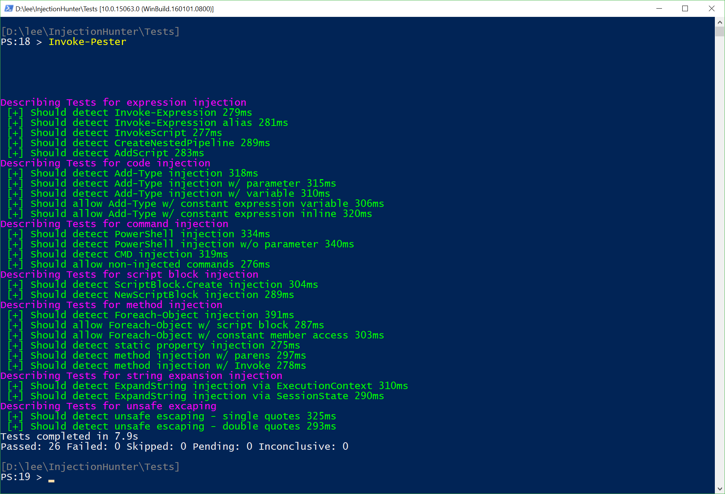
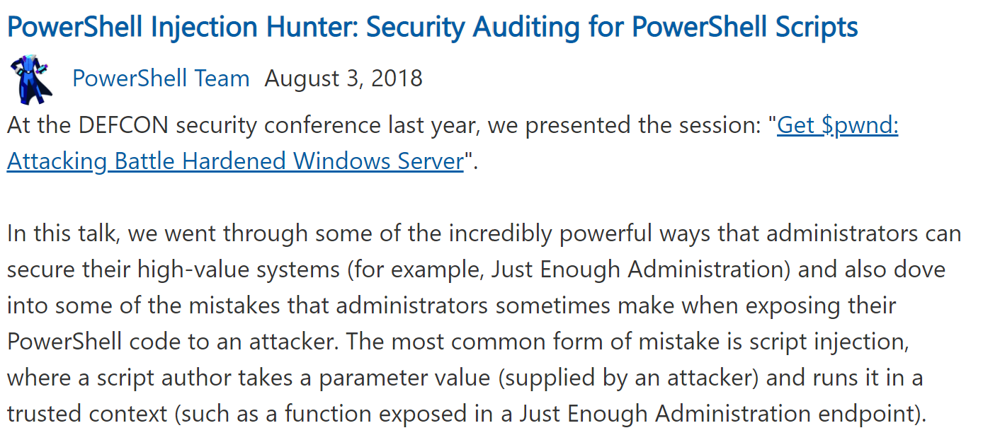
PowerShell Injection Hunter
https://devblogs.microsoft.com/powershell/powershell-injection-hunter-security-auditing-for-powershell-scripts/
Notes:
The PowerShell Injection Hunter module looks for many instances of unsafe coding practices when
PowerShell scripts are exposed to untrusted input
https://devblogs.microsoft.com/powershell/powershell-injection-hunter-security-auditing-for-powershell-scripts/

Slide 52
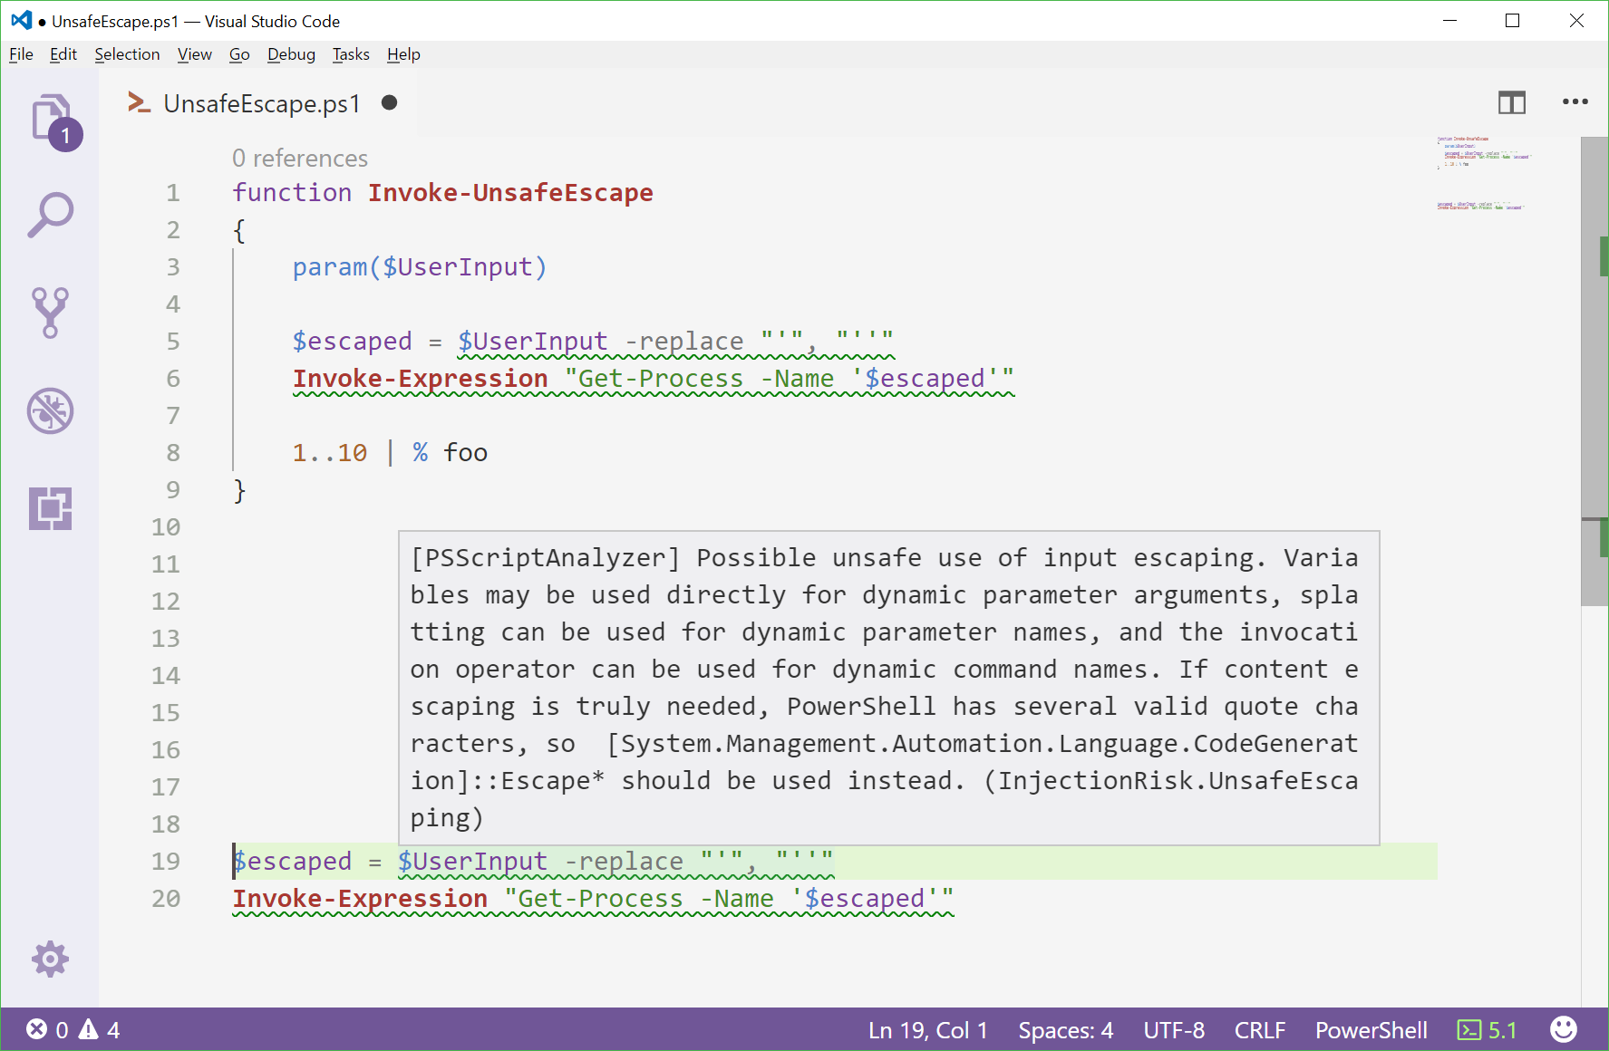
Integration with Visual Studio Code

Slide 53

Notes:
Everything is great now.
Logging
Device Guard
Script Analysis, etc.
Are we done? Almost.

Slide 54
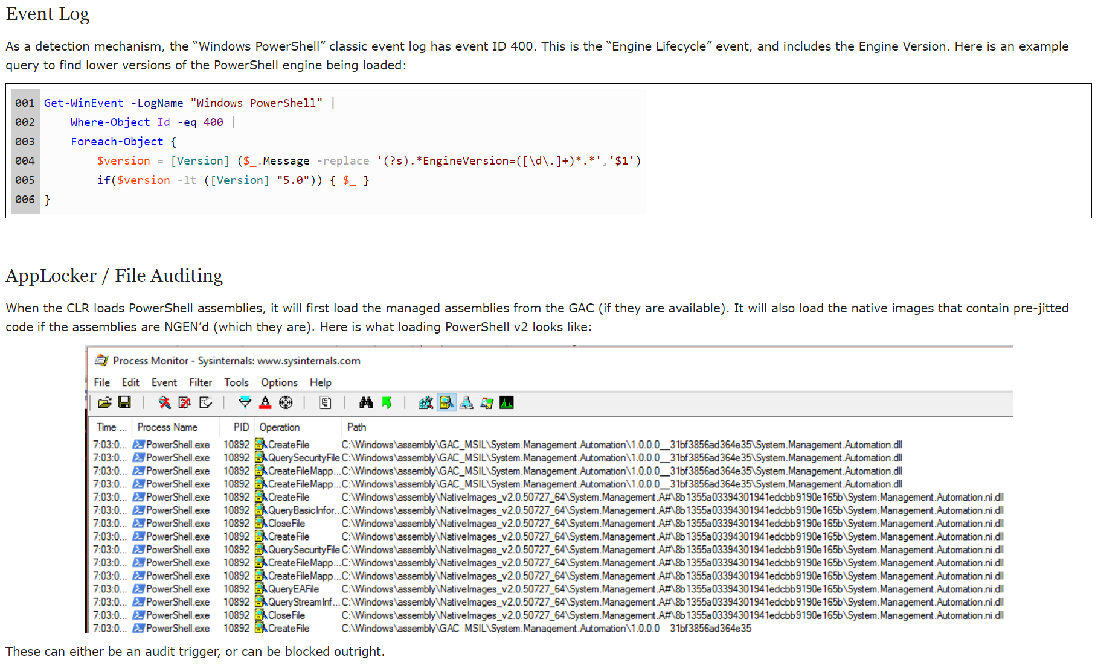
Watch for Downgrade Attacks
http://www.leeholmes.com/blog/2017/03/17/detecting-and-preventing-powershell-downgrade-attacks/
Notes:
Despite all the great improvements in PowerShell v5 and greater, we did not invent time travel.
So V2 of the engine doesn’t have these advances.
Command Line Version Parameter
Hosting Applications Compiled using V2 Reference Assemblies (PSAttack)
Explicitly binding against the V2 CLR (PowerShell Empire PSInject)
Solutions:
PowerShell Event ID 400
File Auditing for System.Management.Automation

Slide 55

Chris Thompson @retBandit
Notes:
From the attacker’s perspective, PowerShell was initially heralded as being a forensically clean, powerful, and modern – a wonderland
where any attack you imagine can come true

Slide 56
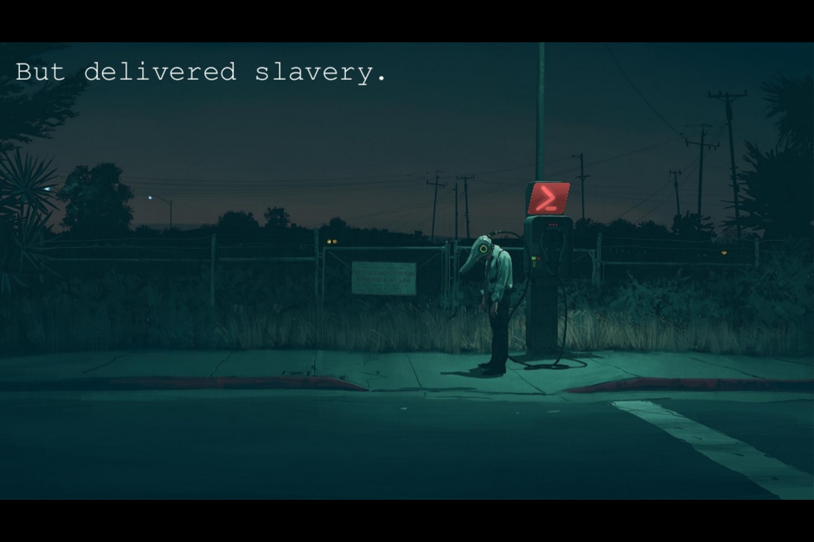
Notes:
In an organization that is aware of, and is monitoring, their PowerShell usage, the opposite is true.

Slide 57
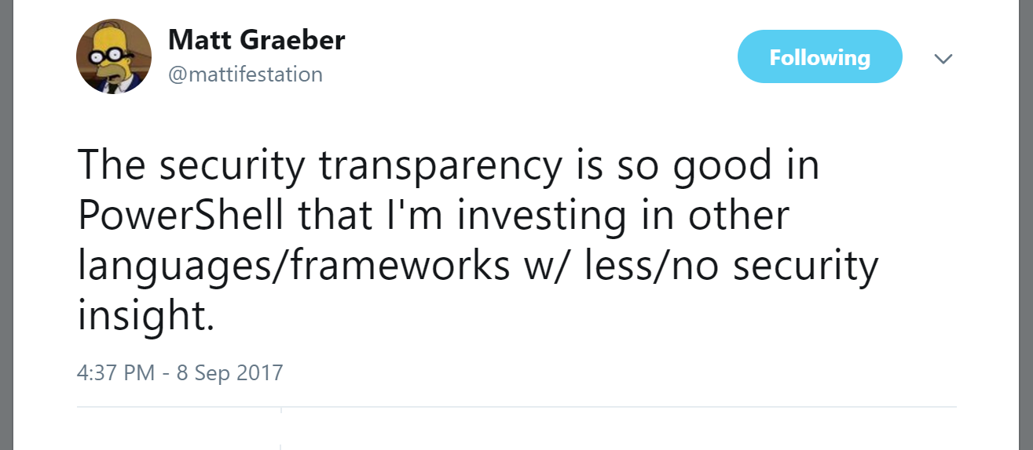
PowerShell: The Ultimate Attacker Honeypot

Slide 58

THANK YOU
This Photo by Unknown Author is licensed under CC BY-SA

Slide 59
References
PowerShell ♥ the Blue Team
https://blogs.msdn.microsoft.com/powershell/2015/06/09/powershell-the-blue-team/
Australian Signals Directorate: Securing PowerShell in the Enterprise
https://www.asd.gov.au/publications/protect/securing-powershell.htm
Maslow’s Hierarchy of Security Controls
http://www.leeholmes.com/blog/2014/12/08/maslows-hierarchy-of-security-controls/
Who’s Afraid of PowerShell Security?
https://blogs.technet.microsoft.com/ashleymcglone/2016/06/29/whos-afraid-of-powershell-security/
Windows Event Forwarding
https://aka.ms/wef
https://technet.microsoft.com/en-us/itpro/windows/keep-secure/use-windows-event-forwarding-to-assist-in-instrusion-detection
Notes:
Some relevant links

